Slide 1
Systems Analysis and Design CT026-3-1
Logical Modelling

Slide 2
Topic & Structure of The Lesson
Data Flow Diagrams
Introduction
Purpose
Steps in developing Data Flow Diagrams
Symbols
Context Diagram

Slide 3
Learning Outcomes
By the end of this lecture, YOU should be able to :
Create logical Modeling:
Context diagram
Data Flow Diagrams – Level 0 and Level 1
Be clear with all
Notations
Standards
Diagram Logic
Labelling
Levelling
Tools

Slide 4
Key Terms you must be able to use
If you have mastered this topic, you should be able to use the following terms correctly in your assignments and exams:
Context Diagram
External Entities
Processes
Data Flows

Slide 5
Purpose of Data Flow Diagrams
to show the processes that data undergo in a system
to show how data moves and changes through an information system in a graphical, top-down fashion
to produce a logical model of an information system in a simple, direct way

Slide 6
Quick Review Question
What is the purpose of the data flow diagram?

Slide 7
Components of DFDs
External Entities / Source & Sink
Process
Data Flow
Data Store

Slide 8
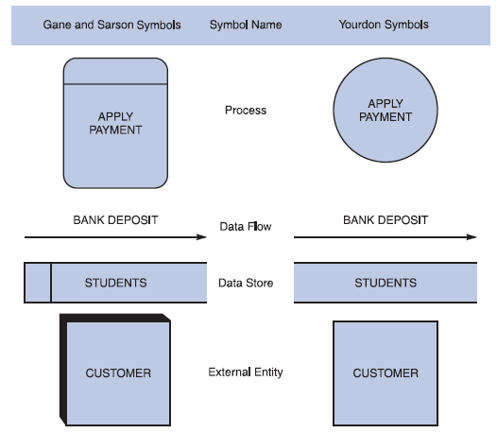
Symbols in DFDs

Slide 9
External Entities / Source & Sink
Also known as terminators
is a person, dept, outside organization or other information system that provides data to the system or receives data from the system
may be a source, a sink or both

Slide 10
External Entities / Source & Sink
source
an external entity that supplies data
Also known as origin
sink
an external entity that receives data
Also known as destination
is named using the singular form of the name

Slide 11
Process
also called a bubble or transform
transforms inputs into outputs
modifies or changes data from one form to another form
is named to identify the function it accomplishes
a diagram should have no more than nine process symbols
name consists of an active verb followed by a singular noun

Slide 12
Data Flow
represents the transfer of data among data stores, sources or sinks, and processes
can represent a specific piece of data – employee names or a set of data – class list – student numbers & student names
detailed contents of a data flow are not shown in a DFD
line can be curved or straight
name consists of adjectives and a singular noun

Slide 13
Data Store
is a data repository
is used when the system must store data because one or more processes need to use the stored data a later time
is a file of any kind: paper, magnetic, or optical
only processes may connect to data stores
name is a plural name consisting of adjectives and a noun

Slide 14
Quick Review Question
What are the notations for:
external entities?
data store?
data flow diagrams?
processes?

Slide 15
Context Diagram
A data flow diagram (DFD) of the scope of an organizational system that shows the system boundaries, external entities that interact with the system and the major information flows between the entities and the system.

Slide 16
Context Diagram
is a top-level view of the information system
has one process symbol representing the entire information system
has the external entities around the perimeter of the page
use data flow to connect the external entities with the process
do not show data store

Slide 17
Context Diagram
Process
What is the name of the system?
External Entities
Who are stakeholders?
Drawn around the perimeter of the page
Data Flows
Rules :
Naming Conventions
Do not represent data flows from entity to entity

Slide 18
Creating a Set of DFDs
Guidelines for Drawing DFDs
Draw the context diagram so that it fits on one page
Use the name of the information system as the process name in the context diagram
Use unique names within each set of symbols
Do not cross lines
Provide a unique name and reference number for each process
Ensure that the model is accurate, easy to understand, and meets the needs of its users

Slide 19
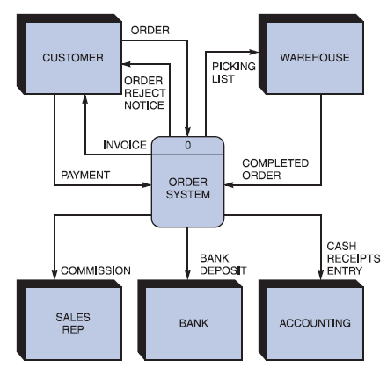
Creating a Set of DFDs
Step 1: Draw a Context Diagram
FIGURE 5-13 Context diagram DFD for an order system

Slide 20
Basic Data Flow Diagramming Rules
Data cannot move directly from source to sink

Slide 21
After the break
Data Flow Diagrams
Levels
Level 0
Level 1
Rules governing the creation of DFDs

Slide 22
Learning Outcomes
By the end of this lecture, YOU should be able to :
Draw a level 0 and 1 data flow diagram based on a context diagram or a given case study.

Slide 23
Key Terms you must be able to use
If you have mastered this topic, you should be able to use the following terms correctly in your assignments and exams:
DFD
Process
External entities
Data flow
Data store

Slide 24
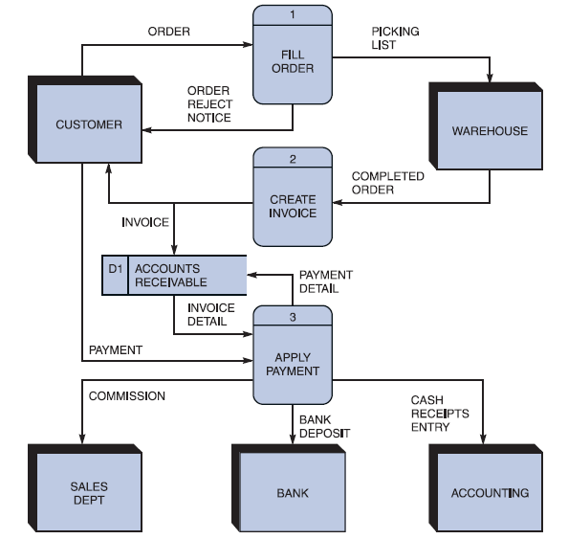
Creating Level 0 DFD
Step 2: Draw a Diagram 0 DFD
If same data flows in both directions, you can use a double-headed arrow
Diagram 0 is an exploded view of process 0
Parent diagram
Child diagram
FIGURE 5-16 Diagram 0 DFD for the order system

Slide 25
Lower-level diagrams
Also called child diagram
Is exploded from parent diagram
When drawn, should be
leveled
also called exploded, partitioned and decomposed
drawn in a series of increasingly detailed diagrams until desired degree of detail is reached
balanced
maintain consistency among the entire series of diagrams

Slide 26
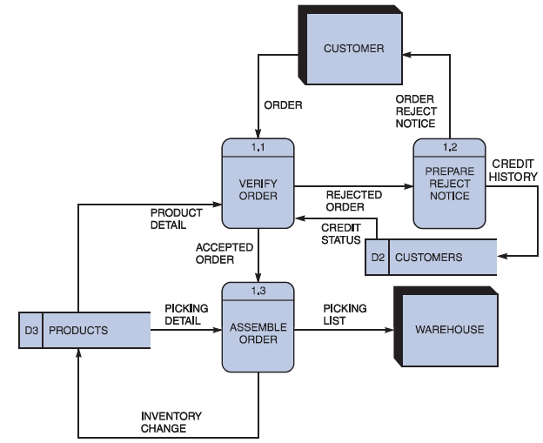
Creating Level 1 DFD
Step 3: Draw the Lower Level Diagrams
Must use leveling and balancing techniques
Leveling examples
Uses a series of increasingly detailed DFDs to describe an information system
Exploding, partitioning, or decomposing
FIGURE 5-17 Diagram 1 DFD shows details of the FILLORDER process in the order system

Slide 27
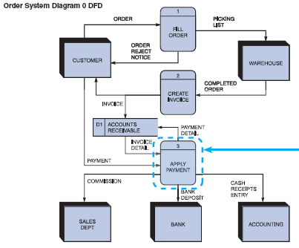
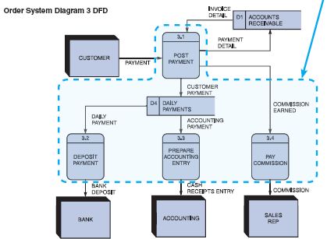
Creating Level 1 DFD
FIGURE 5-19 The order system diagram 0 is shown at the top of the figure, and exploded diagram 3 DFD (for the APPLY PAYMENT process) is shown at the bottom. The two DFDs are balanced because the child diagram at the bottom has the same input and output flows as the parent process 3 shown at the top

Slide 28
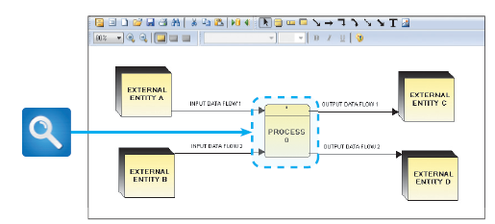
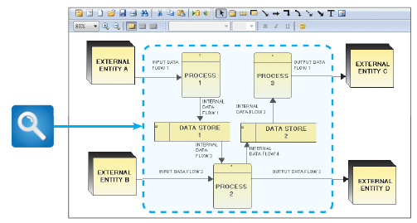
Creating Level 1 DFD
FIGURE 5-20 Example of a parent DFD diagram, showing process 0 as a black box
FIGURE 5-21 In the next level of detail, the process 0 black box reveals three processes, two data stores, and four internal data flows — all of which are shown inside the dashed line

Slide 29
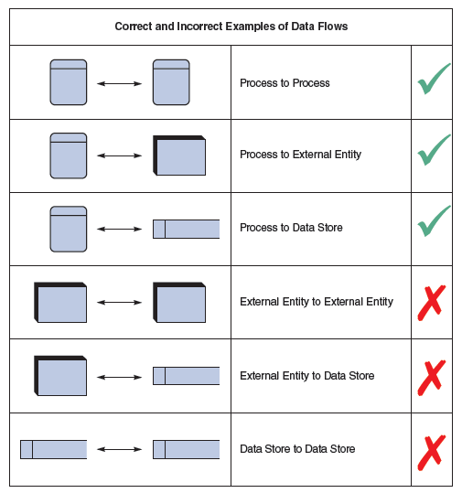
Creating a Set of DFDs
Keep in mind:
All flow lines must be labeled
Large processes can be broken down into smaller components
FIGURE 5-11 Examples of correct and incorrect uses of data flows

Slide 30
Quick Review Question
What are the four main components of a DFD and their shapes?
List 3 main errors for DFD drawing?

Slide 31
Summary of Main Teaching Points
Data Flow Diagrams
Levels
Level 0
Level 1
Rules governing the creation of DFDs

Slide 32
Question and Answer Session
Q & A

Slide 33
What we will cover next
Data Dictionary
What is a Data Dictionary?
Use of a Data Dictionary
Contents of a Data Dictionary
Data Description
Data Structure
Data Element

